Slide 1

Real estate housing analysis
Team #1
Donal tamakuwala
Elena maksimova
Kajal mengar
Mandara kadya
Nadine blaik

Slide 2

Why is the youngest generation struggling to afford houses post pandemic ?
Our hypothesis leads us to believe that it might be due to the relationship between the interest rate and the housing prices.

Slide 3
Questions
1-What is the impact of housing prices in home ownership with young adults ?
2--How are the different provinces responding to the interest rates in term of real estate activity and pricing
3- What are the alternative outlooks to buying a home?
4-What is the relationship/correlation between the interest rate fluctuations and the inflation?
5- What are some of the information that we found to address the housing crisis in Canada ?

Slide 4

Demographic

Slide 5
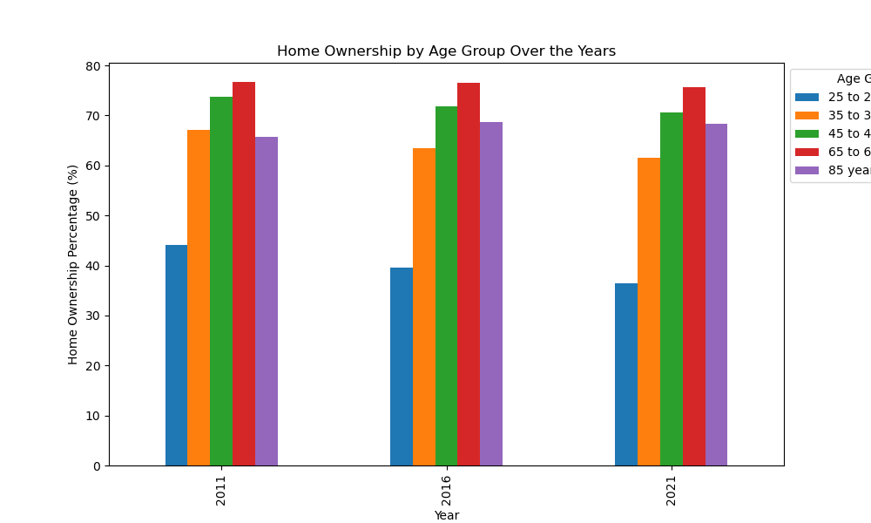

Slide 6
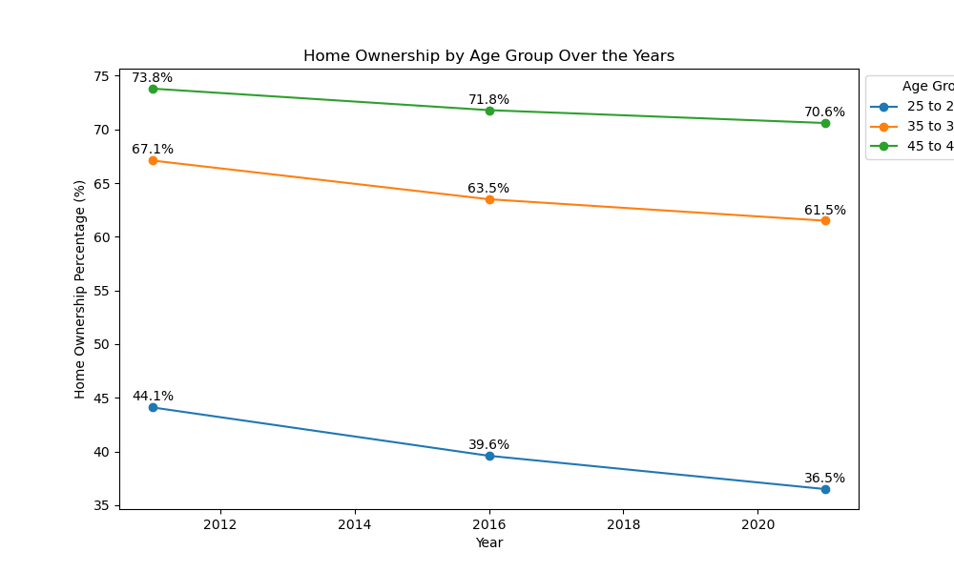

Slide 7
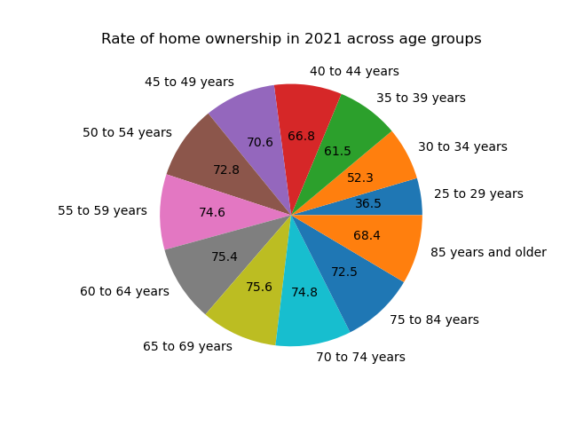

Slide 8

Conclusion
We noticed a trend where home ownerships for the younger age group ( 25-29 years old) have declined over the years. This could be related to the job market, higher inflation and an increase in the cost of life as well as lower wages for jobs. The interest rates would be a secondary cause to what first impacts the decision making that comes with buying a home. The older generations have been able to take advantage of a better economic environment in the past which explains how high their home ownership percentage is.

Slide 9
Housing prices

Slide 10
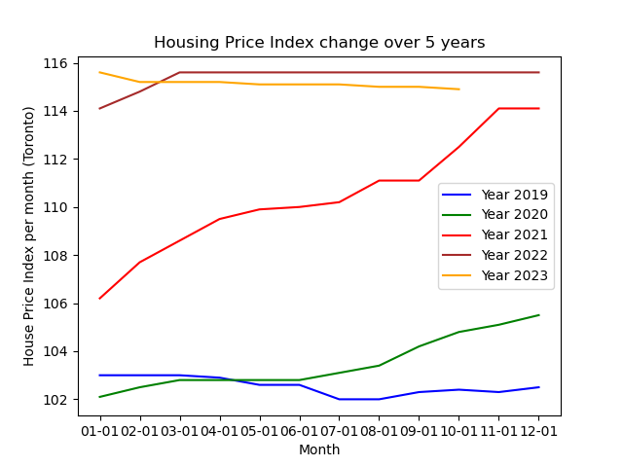

Slide 11
API link - https://api.nytimes.com/svc/search/v2/articlesearch.json?api-key=<>&q=canadian housing market
https://www.nytimes.com/2021/03/05/world/canada/canada-housing-market-covid.html

Slide 12
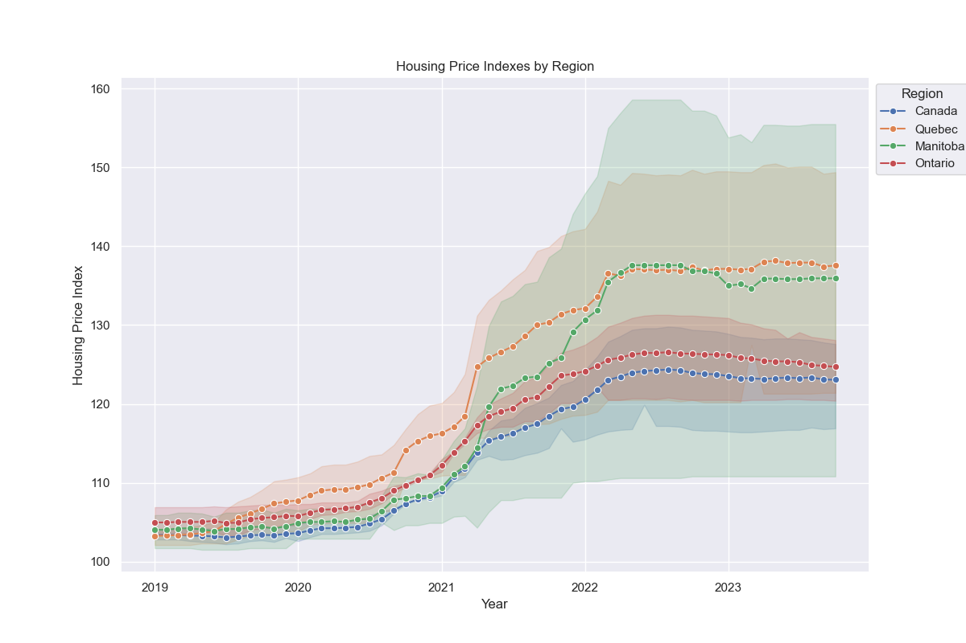

Slide 13
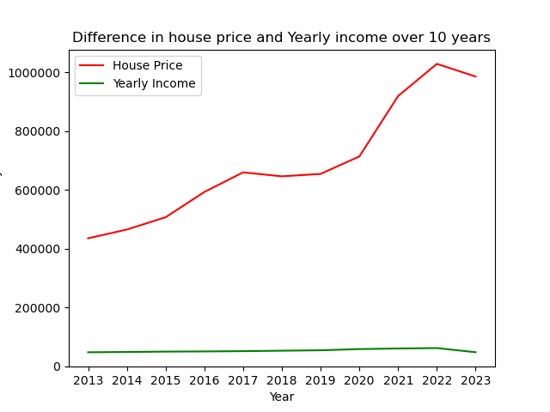

Slide 14

Conclusion
We can notice a significant increase in prices post pandemic. This is sustained by a higher demand and a lower supply of homes. With the interest rate playing a significant role in the buyer’s ability to afford a house. We can observe the higher increase in housing prices in the province of Quebec. Another major notable difference is how the yearly income has increased slightly while the house prices have been soaring.

Slide 15

Interest rates

Slide 16
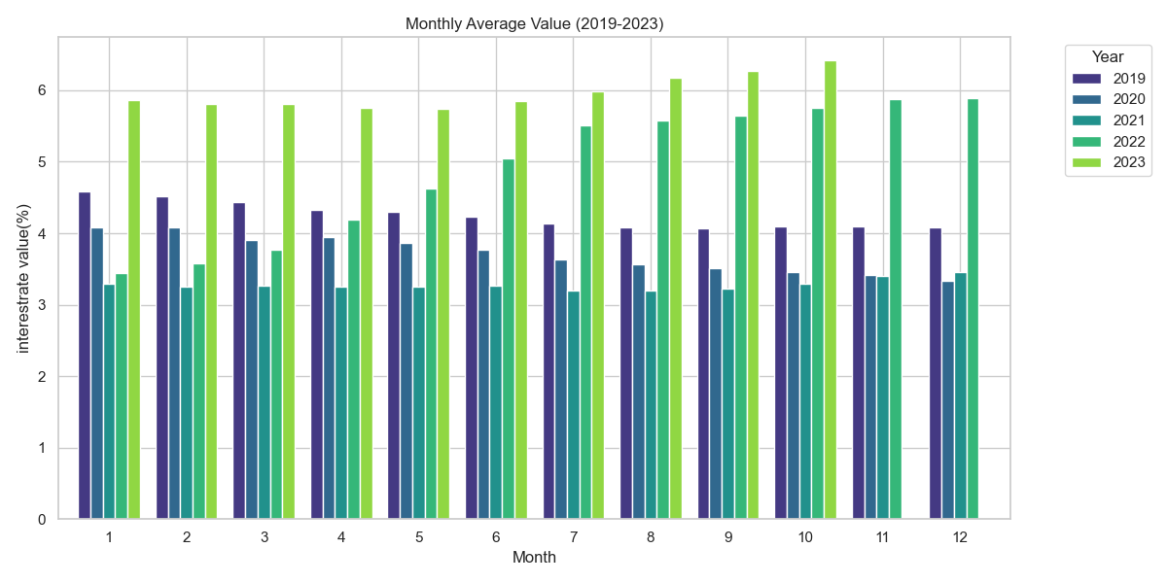

Slide 17
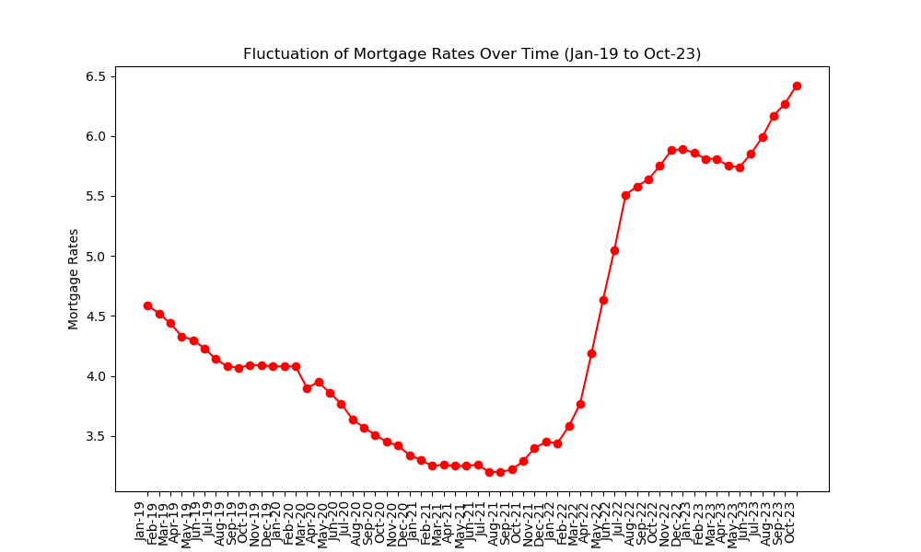

Slide 18
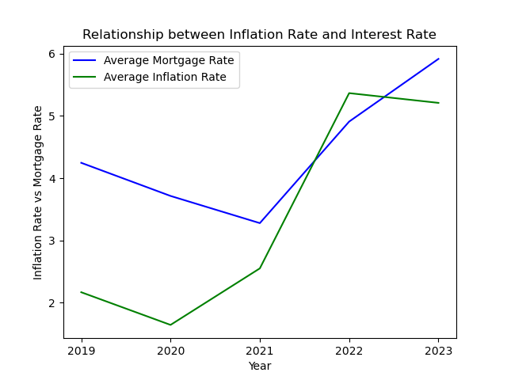

Slide 19

Conclusion
Inflation rate & Interest rate : From 2019 to 2023, as inflationary pressures increased, the Bank of Canada gradually raised interest rates to curb inflation and ensure it remains within its target range. When inflation is high or expected to rise, the central bank may increase interest rates to make borrowing more expensive. Conversely, when inflation is low or below the target range, the central bank may lower interest rates to stimulate borrowing and spending, thereby boosting economic activity. The relationship between inflation rates and interest rates is not always linear or immediate

Slide 20
Conclusion How can this analysis be taken to the next level

Slide 21
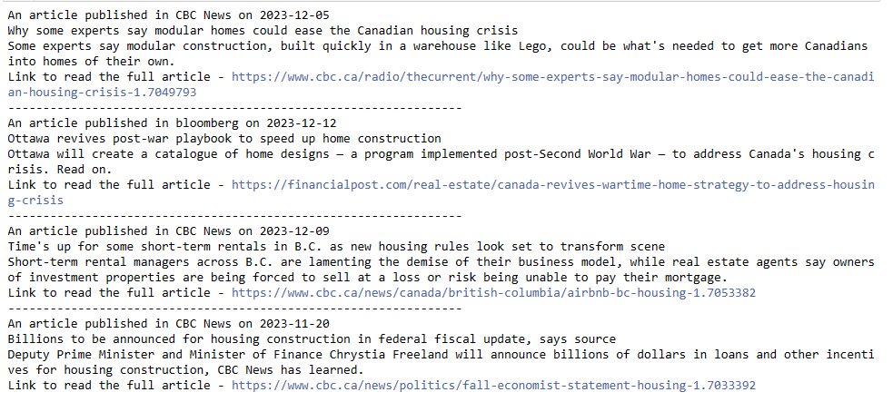
https://www.cbc.ca/radio/thecurrent/why-some-experts-say-modular-homes-could-ease-the-canadian-housing-crisis-1.7049793 https://financialpost.com/real-estate/canada-revives-wartime-home-strategy-to-address-housing-crisis https://www.cbc.ca/news/canada/british-columbia/airbnb-bc-housing-1.7053382 https://www.cbc.ca/news/politics/fall-economist-statement-housing-1.7033392

Slide 22
Notice
Limitations:
Impact of immigration on housing
Supply and Demand of housing
Rental market
analysis was made primarily for Ontario region and not the other provinces

Slide 23

References
https://www150.statcan.gc.ca/n1/daily-quotidien/220921/cg-b002-eng.htm
House Price Index - https://www.kaggle.com/datasets/anki112279/canada-housing-price-data-by-regions-19812022
Mortgage Rate - https://open.canada.ca/data/en/dataset/ae607e9a-2fce-4ed9-83e3-ba4cdbc24b8d/resource/22c8bc22-2bd4-41b6-8da5-ee57672a1d5f
https://www.kaggle.com/datasets/anki112279/canada-housing-price-data-by-regions-19812022
https://www150.statcan.gc.ca/n1/daily-quotidien/220921/cg-b002-eng.htm
https://open.canada.ca/data/en/dataset/ae607e9a-2fce-4ed9-83e3-ba4cdbc24b8d/resource/22c8bc22-2bd4-41b6-8da5-ee57672a1d5f
https://www.crea.ca/housing-market-stats/mls-home-price-index/hpi-tool/
https://www150.statcan.gc.ca/t1/tbl1/en/cv.action?pid=1410022201
https://www150.statcan.gc.ca/t1/tbl1/en/tv.action?pid=1810025901

Slide 24

Q & A

